Slide 1

Digital Privacy

Slide 2

About Me
Information Security consultant with Secify
Group Information Security manager with Husqvarna Group
Information Security advisor, system administrator & IT trainer with British Diplomatic Service
Compliance auditor with HM Revenue & Customs
Digital forensics examiner with National Crime Squad

Slide 3
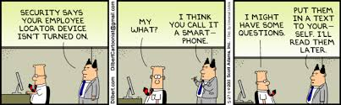
Objectives
To introduce privacy and some introductory steps & tools people can take to protect themselves
To provide information that can be used help protect friends and family
Notes:
Emphasise this is a very brief INTRODUCTION to a topic that could be 3 days training!
This is aimed to be an introduction of the basics, I would like to build this as a series of presentations to develop into more complex areas such as add-ons for different browsers. But I think we all too often forget the basics.
Emphasise that its no good protecting ourselves if we don’t help those around us protect themselves… our footprint may be minimal but our shadow created by others huge

Slide 4
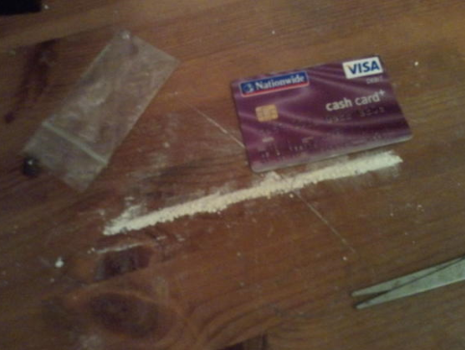
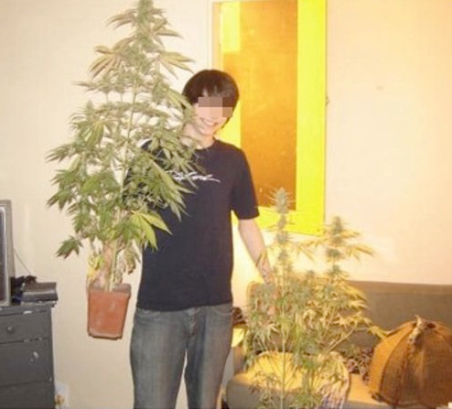
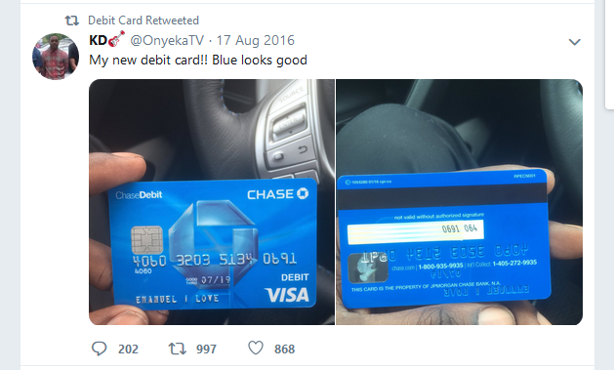
Privacy
What IS privacy?
Subjective definition!
Cultural & geographical influences
Risk based – real life vs online
Personal choice about what we share….
knowing what is too much!
Notes:
https://twitter.com/needadebitcard?lang=en

Slide 5


Digital Footprints & Shadows
Footprint: What traces YOU leave behind
What you share
What your browser shares
What your device shares
Shadow: What traces OTHERS leave about you
Friends & family
Organisations
Notes:
Can you remember where you uploaded data in the past week? Past month? Past year? Past 5 years?

Slide 6

Your Personal Data
WHERE it is?
WHO has it?
HOW public it is?
HOW LONG will it exist?
Impact of Big Data & Open Source information?
Dark web?
Notes:
Can you remember where you uploaded data in the past week? Past month? Past year? Past 5 years?

Slide 7
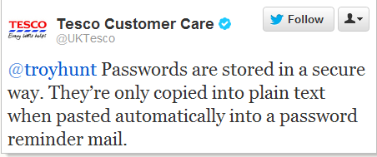
Basics
Passwords
Password managers
Password USBs
File storage:
Where?
How?
Risk assess
Devices:
Encrypt mobile devices and secure with pin/password
Block autorun for USB devices

Slide 8
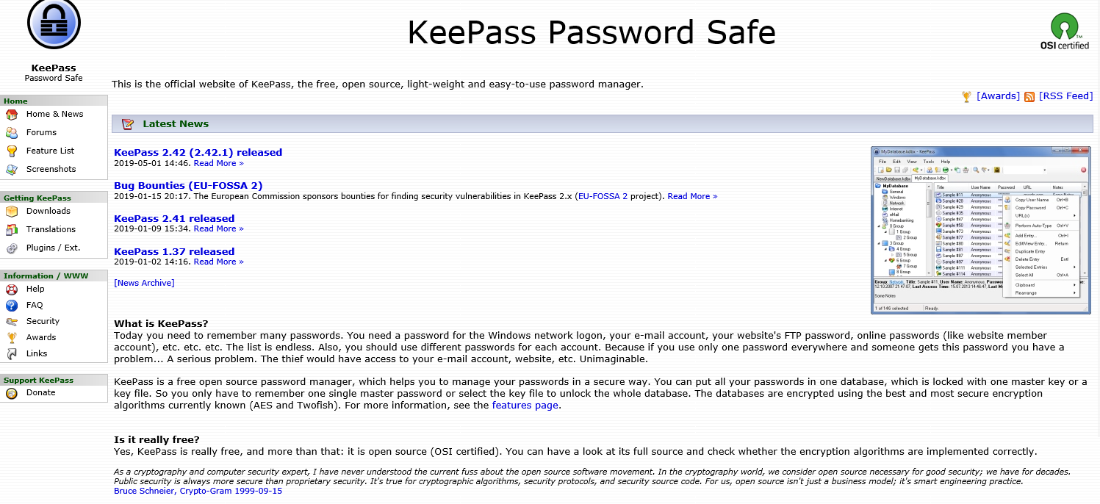
https://keepass.info/
Notes:
Quick overview

Slide 9
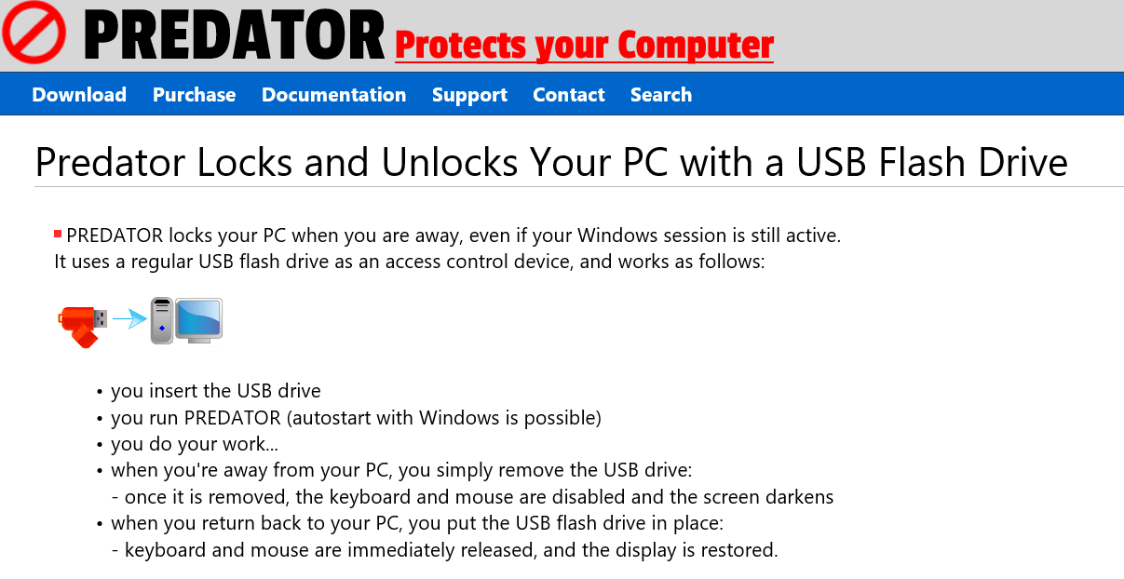
https://www.predator-usb.com/predator/en/index.php
Notes:
Quick overview

Slide 10
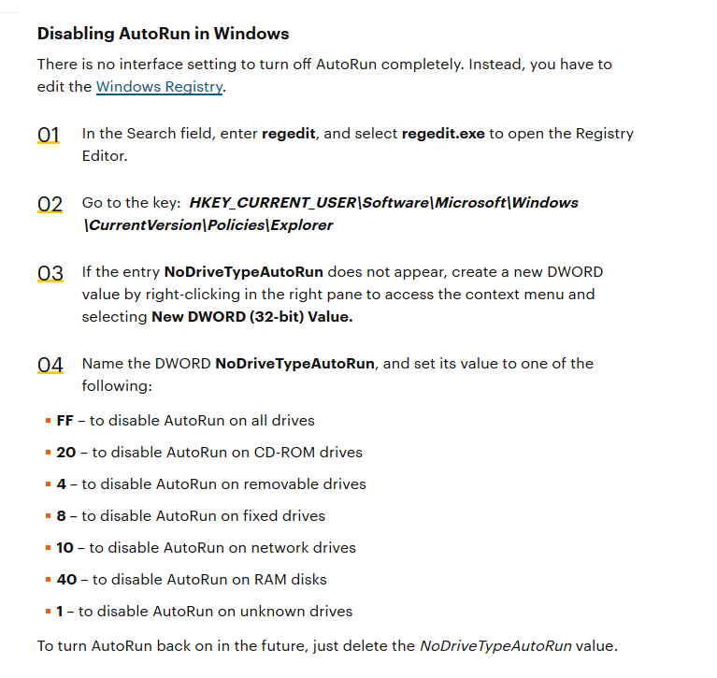
Stopping USBs Autorunning Software
If this is a potential risk to you, edit the registry to prevent malware autorunning
Use an Open Source tool

Slide 11
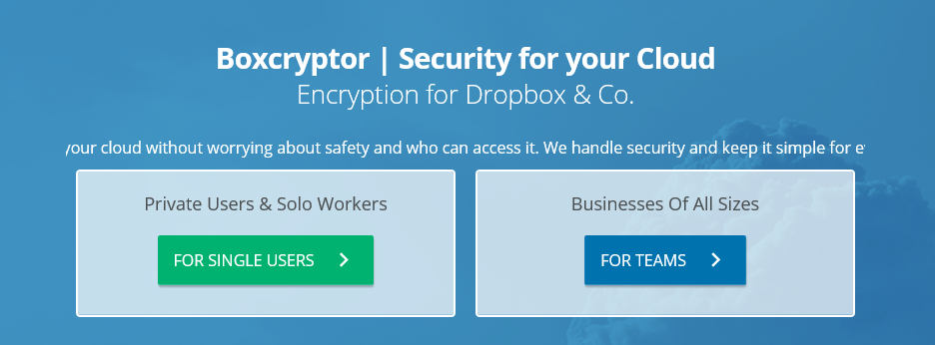
Cloud Storage
Boxcryptor will encrypt your data before uploading to the cloud provider
Works with most cloud providers
Free for home users up to 2 devices, $48 per year for unlimited devices
https://www.boxcryptor.com/en/
Notes:
Cant demo but massively useful to know about. Useful to know about cloud fogger too

Slide 12
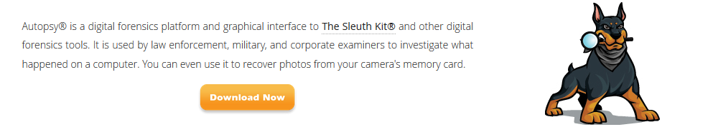
Recovery of data & Secure Wipes
Best option, back up, TEST and consider an encrypted cloud backup
If backups fail, forensic tools are a recovery option
Also provide secure wipe
Will do a footprint scan of your pc
Autopsy is a free windows based tool. Sleuth Kit
https://www.sleuthkit.org/autopsy/
Notes:
Give a brief pre-prepared demo of Autopsy on thumbs.db and show secure wipe functionality
Disposal and not wiping, or understanding the footprint left is a massive problem for people and their privacy

Slide 13
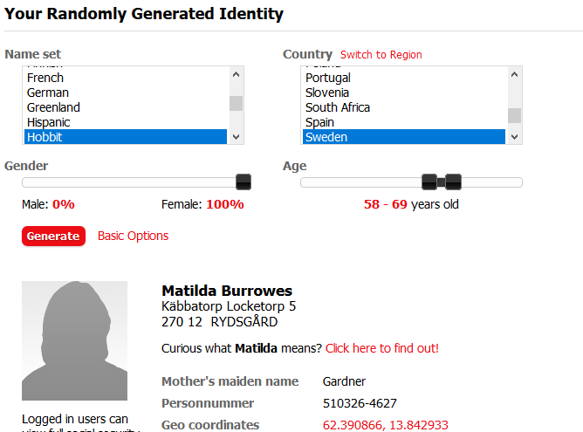
Do You REALLY Need to Give Your Real Data?
If the answer is no, don’t give it!
Use a fake profile using FakeNameGenerator.com
Consider a disposable mail account

Slide 14
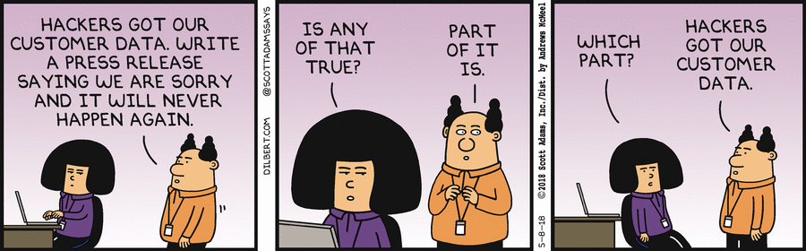
Some Useful Privacy Tools
www.Justdelete.me
www.Accountkiller.com
https://privacy.net/analyzer/
Panoptic
EFF SSD
Abine.com
CC Cleaner
Duck Duck Go
Tor
Notes:
Just a sample…

Slide 15
Any Questions?

